Slide 1
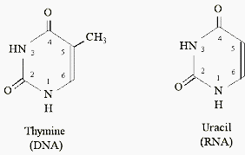
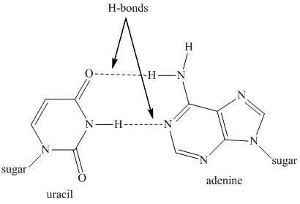
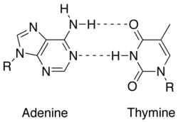
Structure and function of RNAs
Lecture - 7

Slide 2
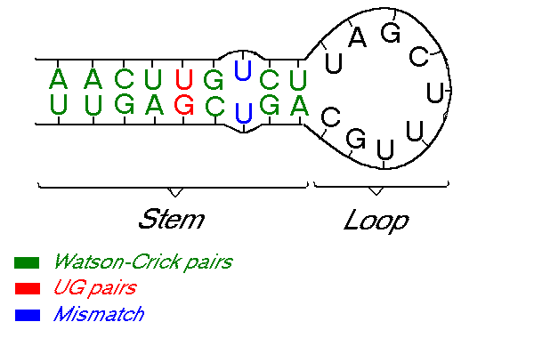
Double helical character of RNA
Despite being single-stranded, RNA molecules often exhibit a great deal of double-helical character.
This is because RNA chains frequently fold back on themselves to form base-paired segments between short stretches of complementary sequences
Wobble base pair

Slide 3
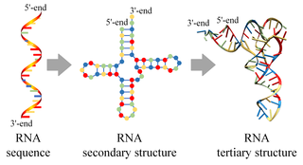

Slide 4
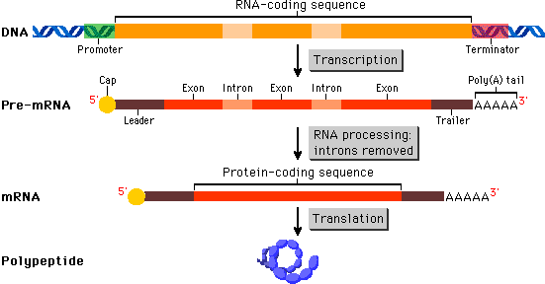
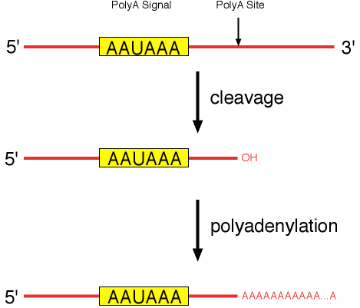
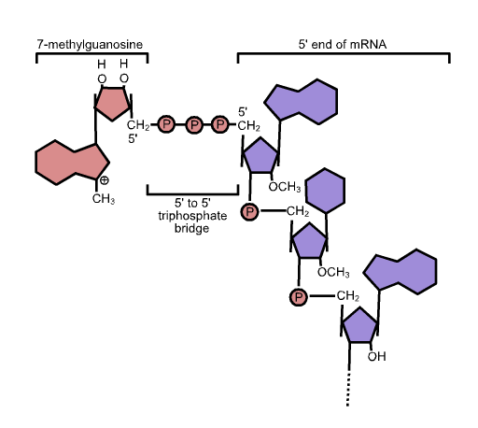
Messenger RNA (mRNA)
Regulation of nuclear export
Protection against degradation by exonucleases
Promotion of translation

Slide 5
Riboswitch
Riboswitches are structural elements commonly found in the 5′-untranslated region (UTR) of mRNAs that exert their regulatory control over the transcript in a cis-fashion by directly binding a small molecule ligand

Slide 6
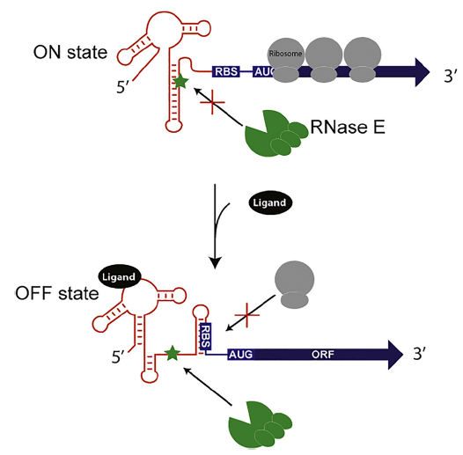
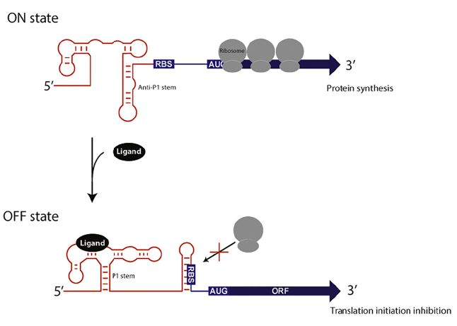
Mechanism of action of riboswitches
Riboswitch-dependent control of mRNA decay
Riboswitch regulation of translation initiation
Notes:
The plethora of natural riboswitch ligands includes purines and their derivatives, coenzymes, amino acids, a phosphorylated sugar, inorganic ligands including metal cations and fluoride anions

Slide 7
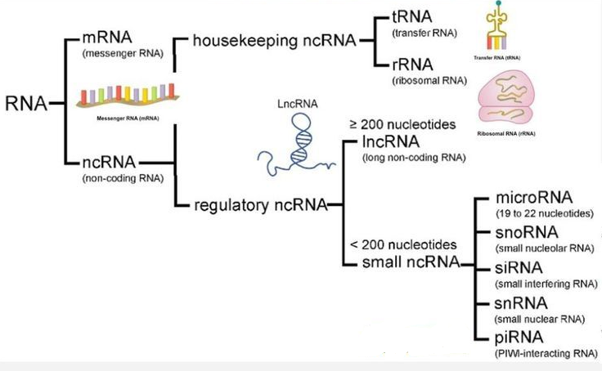
Coding vs non-coding RNAs

Slide 8
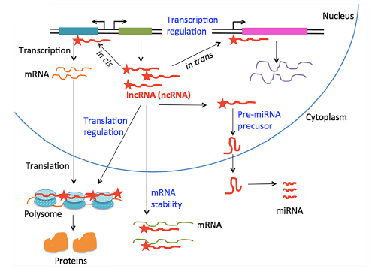
LncRNA mediated regulation of gene expression
Mol Genet Genomics (2018) 293:1–15

Slide 9
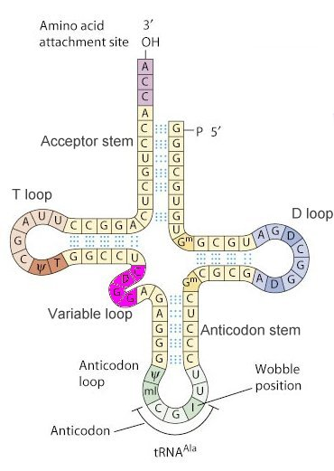
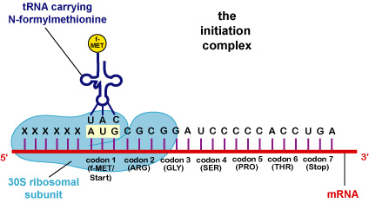
Transfer RNA (tRNA)

Slide 10
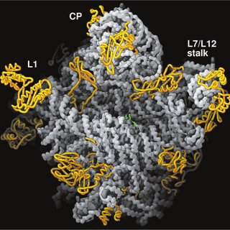
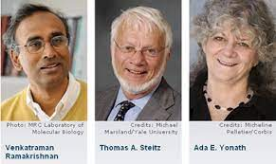
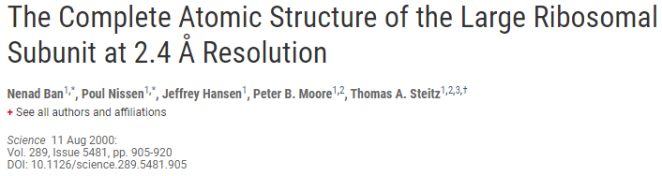
Ribosomal RNA (rRNA)
2009 Nobel Prize in Chemistry
Notes:
Prokaryotic ribosomes are around 20 nm (200 Å) in diameter and are composed of 65% rRNA and 35% ribosomal proteins.
Prokaryotes have 70S ribosomes, each consisting of a small (30S) and a large (50S) subunit. E. coli, for example, has a 16S RNA subunit (consisting of 1540 nucleotides) that is bound to 21 proteins. The large subunit is composed of a 5S RNA subunit (120 nucleotides), a 23S RNA subunit (2900 nucleotides) and 31 proteins.^{[16]}

Slide 11
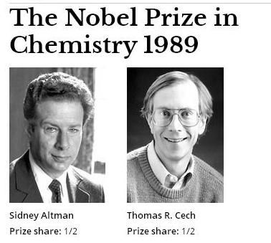
Ribozymes
"for their discovery of catalytic properties of RNA."

Slide 12
Catalytic activity of RNA
  RNA catalyzes excision/ligation in introns.
  RNA catalyzes the maturation of tRNA.
  RNA catalyzes peptide bond formation.
Notes:
Self-splicing occurs for rare introns that form a ribozyme, performing the functions of the spliceosome by RNA alone. There are three kinds of self-splicing introns, Group I, Group II and Group III. Group I and II introns perform splicing similar to the spliceosome without requiring any protein. This similarity suggests that Group I and II introns may be evolutionarily related to the spliceosome. Self-splicing may also be very ancient, and may have existed in an RNA world present before protein. Self-splicing occurs for rare introns that form a ribozyme, performing the functions of the spliceosome by RNA alone. There are three kinds of self-splicing introns, Group I, Group II and Group III. Group I and II introns perform splicing similar to the spliceosome without requiring any protein. This similarity suggests that Group I and II introns may be evolutionarily related to the spliceosome. Self-splicing may also be very ancient, and may have existed in an RNA world present before protein.

Slide 13
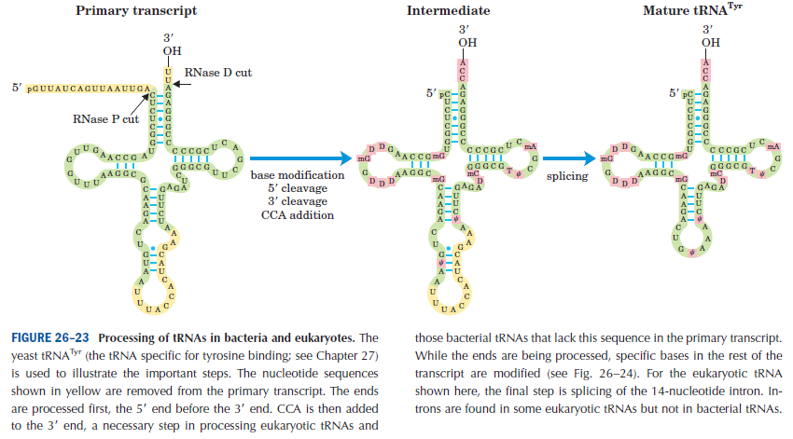
Processing of tRNAs in bacteria and eukaryotes
Notes:
Ribonuclease P (EC 3.1.26.5, RNase P) is a type of ribonuclease which cleaves RNA. RNase P is unique from other RNases in that it is a ribozyme – a ribonucleic acid that acts as a catalyst in the same way that a protein-based enzyme would. Its function is to cleave off an extra, or precursor, sequence of RNA on tRNA molecules.^{[1]} Further, RNase P is one of two known multiple turnover ribozymes in nature (the other being the ribosome), the discovery of which earned Sidney Altman and Thomas Cech the Nobel Prize in Chemistry in 1989: in the 1970s

Slide 14
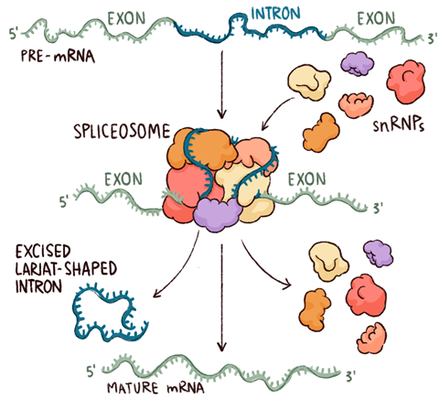
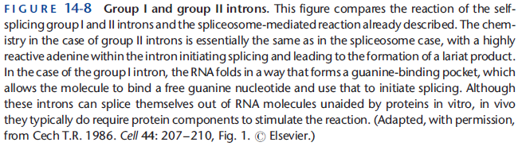
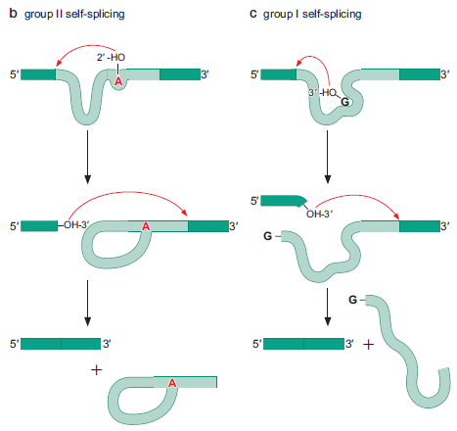
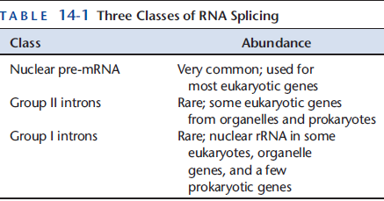
Self-splicing introns

Slide 15
